Slide 1
Conduent Go-Live Training v3
Mikhail Kozorovitskiy
Consulting Engineer
Jason van Brackel
Consulting Architect
Cris Rusu
Consulting Engineer
05.04.20 – 05.19.20

Slide 2
Course Overview
1
Overview Assessment
2
Cluster Management with Rancher
Rancher & AKS Cluster Setup
Working with Rancher
RBAC Projects & Namespaces
Monitoring & Logging
3
4
5
6
Kubernetes Fundamentals
Security
Operational Usability
Concluding Discussions

Slide 3
Course Schedule
Each block is roughly meant to be taught in a half-day three to four hour period.
Block 1 | Block 2 | Block 3 | Block 4 | Block 5
1. Overview and Assessment | 2.2 Working with Rancher | 2.5 Projects & Namespaces | 2.7 Monitoring | 2.9 Continued Discussions
2.1 Rancher Setup | 2.3 Deploying Clusters with Rancher | 2.6 PVC & Storage Classes | 2.8 Logging | 2.10 Rancher Q & A
 | 2.4 RBAC w/ Azure AD
Block 6 | Block 7 | Block 8 | Block 9 | Block 10
3.1 Jobs | 4.1 Network Policies | 5.1 Debugging | 5.3 Scaling AKS | 6.1 Continued Discussion Topics
3.2 Cron Jobs | 4.2 Pod Security Policies | 5.2 Application Versioning | 5.4 Out of Resource Handling | 6.2 Training Q & A
3.3 CRDs | 4.3 SSL Termination
 | 4.4 Secure Storage

Slide 4
Course Updates & Overview
Azure Go-Live Training
Customized for Conduent
Hands-on working with Rancher
Hands-on working in AKS
Does not cover all Fundamentals
Further Resources
Labs for Section 2:
https://drive.google.com/open?id=1rzOny4PlzcXrnqgeO-REPAc--IdzyDw4

Slide 5
Block 1
1.1
Course Updates and Overview
1.2.2
Rancher Overview
1.2.3
Local Setup and Environment
Overview and Setup
2.1
Rancher Setup

Slide 6


1.2.2 Rancher Overview
Rancher Server
Kubernetes Cluster
Kubernetes Workload Cluster A
Kubernetes Workload Cluster B

Slide 7
1.2.2 Rancher Overview
Multi-Cloud Kubernetes Management
RBAC with many backend Providers including Azure Active Directory
Strives to be Kubernetes “Easy Button”
Monitoring
Logging
Notifications
Utilizes Standard Kubernetes API with some CRDs
Deployable with Helm Chart

Slide 8
Block 1
1.1
Course Updates and Overview
1.2.2
Rancher Overview
1.2.3
Local Setup and Environment
Overview and Setup
2.1
Rancher Setup

Slide 9
1.2.3 Local Lab Setup & Environment
Applications
helm 2
azure cli 2.2
rancher cli 2.3
kubectl 2.3.2
docker 19.03
rke cli 1.0.5
Hosting Environment
Full Access to Empty Azure Account *
* Usage in a utilized account could unintentionally effect existing infrastructure.

Slide 10
Block 1
1.1
Course Updates and Overview
1.2.2
Rancher Overview
1.2.3
Local Setup and Environment
Overview and Setup
2.1
Rancher Setup

Slide 11
2.1 Setup Rancher
Requirements for HA
Install On AKS not Supported. Utilize RKE
Upgrading
Custom Image Registries
Environments
LAB: Setup Rancher on Cluster

Slide 12
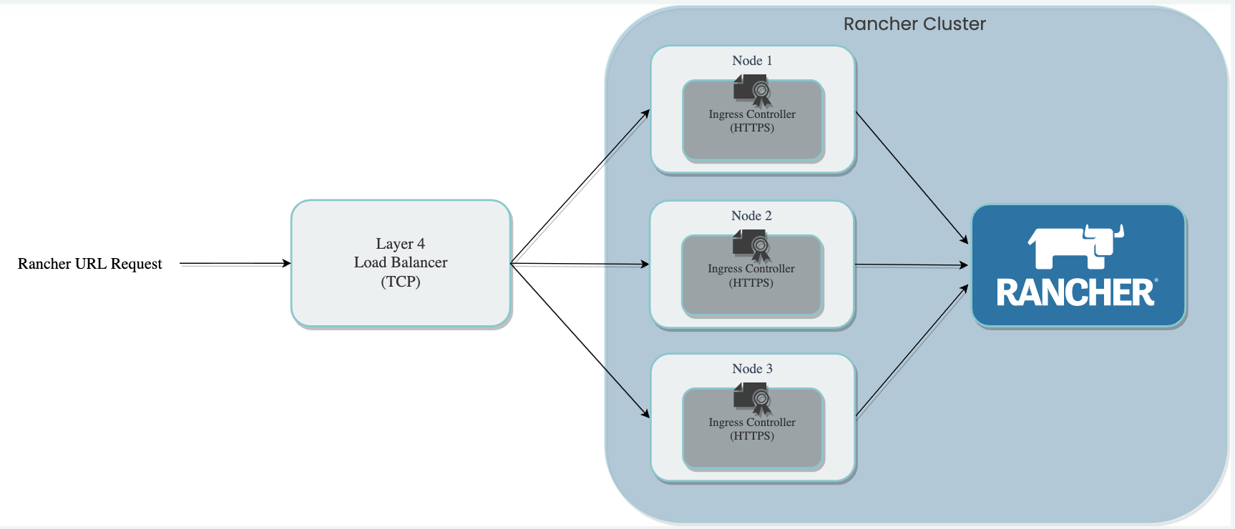
2.1.1 High Availability Deployment

Slide 13
2.1 Continued – AKS vs RKE
2.1 AKS Default Networking Intermittent Socket Failure Running Rancher
Originally thought it was Nginx Ingress Related
Experienced Failure to Import clusters & Manage Rancher Created Clusters
Azure CNI may solve this in future.
Rancher Certified For HA
RKE
k3s
Rancher Development Single Node
Docker
RKE
k3s

Slide 14
2.1.6 LAB: Replace Rancher with RKE Instance
/Section 2/Labs/2.1.6/

Slide 15
2.1.6 LAB: Replace Rancher with RKE Instance
Remove Previous Instance & Resource Groups Prior to Starting.
Azure Resources
Create Resource Group
Create SSH Key
Create Scalable VM Set
Set LB Rules
Deploy via RKE CLI
RKE https://rancher.com/docs/rke/latest/en/installation/
Configure Helm and Install Rancher
Helm
Cert-Manager
Rancher
Get all to get new IP for Cluster.

Slide 16
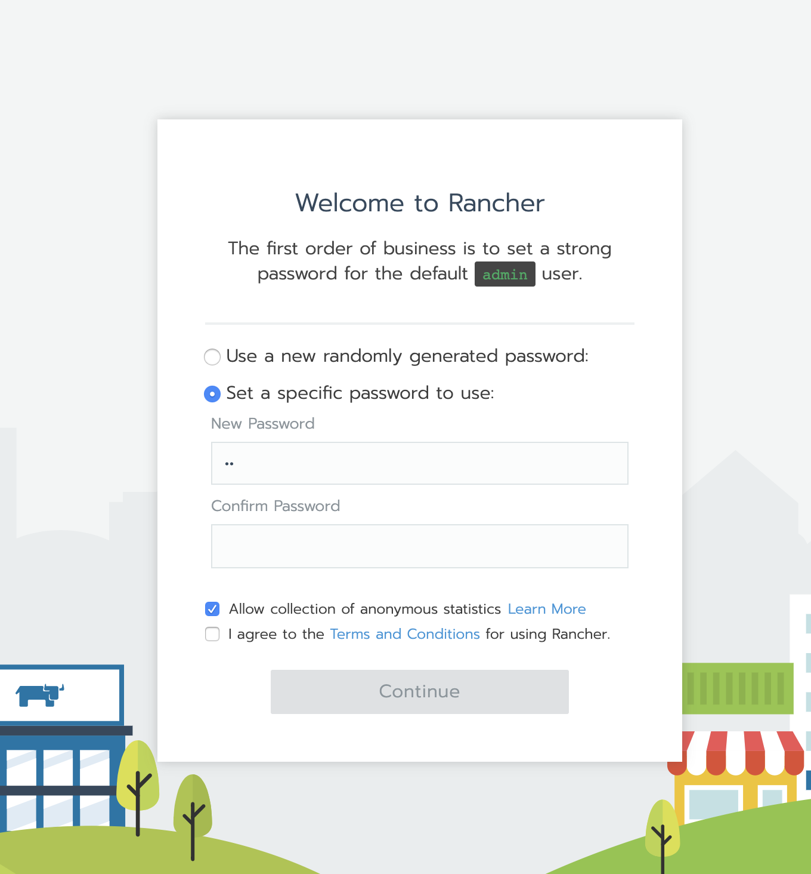
2.1.6 LAB: Replace Rancher with RKE Instance

Slide 17
Cluster Management with Rancher

Slide 18
Block 2
2.2
Working with Rancher
2.3
Deploying Clusters with Rancher
2.4
RBAC /w Azure AD
Cluster Management with Rancher

Slide 19
2.2 Working with Rancher
Web UI
Demo: Rancher UI
CLI
https://rancher.com/docs/rancher/v2.x/en/cli/
LAB: Add Project
API
https://rancher.com/docs/rancher/v2.x/en/api/
Terraform
https://www.terraform.io/docs/providers/rancher2/r/cluster.html

Slide 20

2.2.1 How does the Rancher UI work?
Rancher is the client to your Kubernetes cluster’s API
UI can only do what is provided by the Kubernetes API
Anything you can do in the UI can be done through API
Rancher periodically polls k8s endpoints to maintain state of the world (aka “kubectl describe”)

Slide 21
2.2.2 LAB: Rancher CLI – Add Project
/Section 2/Labs/2.2.2/

Slide 22
2.2.2 LAB: Rancher CLI – Add Project
Download Rancher CLI
Get Rancher Token and Server URL
Login
Add Project
Add Namespace
Move Namespace to project

Slide 23
Block 2
2.2
Working with Rancher
2.3
Deploying Clusters with Rancher
2.4
RBAC /w Azure AD
Cluster Management with Rancher

Slide 24
2.3 Deploying Clusters with Rancher
AKS Provisioning
LAB: Add AKS Cluster in UI
Importing Clusters
LAB: Import Cluster with UI
LAB: Import Cluster with CLI
LAB: Add RKE Cluster on Azure via UI

Slide 25
2.3.2 LAB: Add AKS Cluster in UI
/Section 2/Labs/2.3.2/

Slide 26
2.3.2 LAB: Add AKS Cluster in UI
Azure Portal: Add Service Principal
Create Resource Group
Add Application
Add Contributor Role
Rancher UI: Add Cluster
Add Cluster
Input and Validate Credentials
Configure Cluster and Create

Slide 27
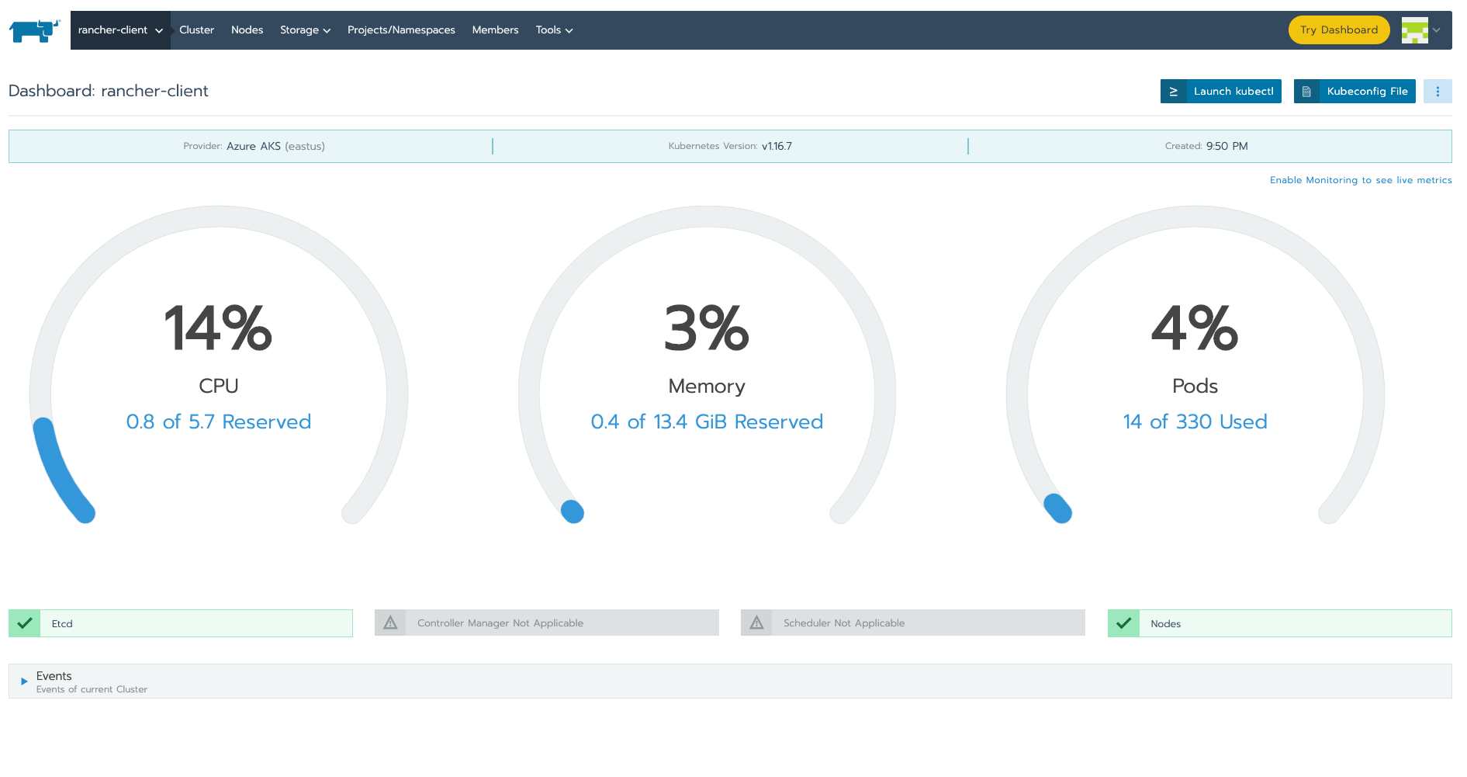
2.3.2 LAB: Add AKS Cluster in UI

Slide 28

2.3.3 Cluster Import
Importing a cluster involves starting a deployment containing the rancher cluster agent.
ClusterRole and ClusterRoleBinding are also created to provide required permissions to cluster agent.
Agent opens a connection back to the Rancher server URI to maintain API integration.
All provisioners by default perform the import step automatically.
Rancher Management Server
Cluster
Agent
Kubernetes Cluster
Notes:
- Agent provides a websocket persistent connection to the Rancher server; this makes it easy to manage Firewall rules

Slide 29
2.3.4 LAB: Import Existing Cluster
/Section 2/Labs/2.3.4/

Slide 30
2.3.4 LAB: Import Existing Cluster
Add Cluster via Portal or via CLI
Add A Resource Group
Add Cluster ⏳
Get Credentials
Add to Rancher via Import UI
Add Cluster
Import Existing
Select Name
Install Rancher Agent Using Self Signed SSL

Slide 31
2.3.5 – LAB: Import Cluster via Rancher CLI
/Section 2/Labs/2.3.5/

Slide 32
2.3.5 – LAB: Import AKS Cluster via Rancher CLI
Azure Resources
Create Resource Group
Create AKS Cluster
Get Service Principal
Rancher CLI
Create Cluster
Import Cluster
Run insecure import

Slide 33
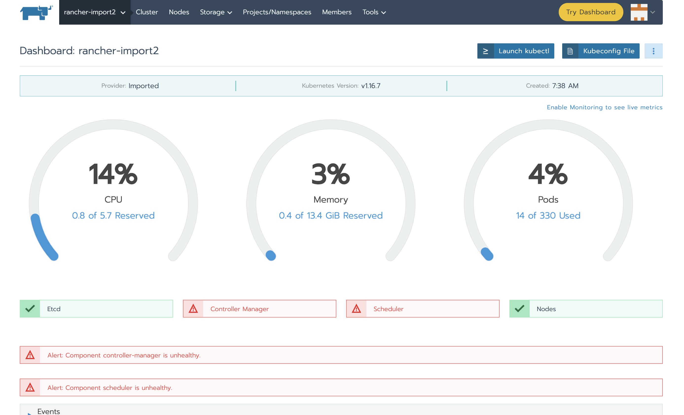
2.3.5 – LAB: Import AKS Cluster via Rancher CLI

Slide 34
2.3.6 LAB: Add RKE Cluster on Azure via UI
/Section 2/Labs/2.3.6/

Slide 35
2.3.5 LAB: Add RKE Cluster on Azure via UI
Create Azure Credentials via CLI
Add A Resource Group
Add Application
Add in Rancher via UI
Add Credentials
Add Node Templates
Add RKE Cluster

Slide 36
Block 2
2.2
Working with Rancher
2.3
Deploying Clusters with Rancher
2.4
RBAC /w Azure AD
Cluster Management with Rancher

Slide 37
Block 2
2.2
Working with Rancher
2.3
Deploying Clusters with Rancher
2.4
RBAC /w Azure AD
Cluster Management with Rancher

Slide 38
2.4 RBAC with Azure AD
Setting Up Integration
https://rancher.com/docs/rancher/v2.x/en/admin-settings/authentication/azure-ad/
Using Group Permissions from AD
LAB: Connecting Rancher to Existing AD

Slide 39
2.4.3 LAB: Connecting Rancher to Existing AD
/Section 2/Labs/2.4.3/

Slide 40
2.4.3 LAB: Connecting Rancher to Existing AD
Register App In Portal
Create an App Registration with Rancher Key
Add Client Secret
Add API Permissions
Save Grant
Insert Credentials into Rancher and Save
Add Group Based Permissions

Slide 41
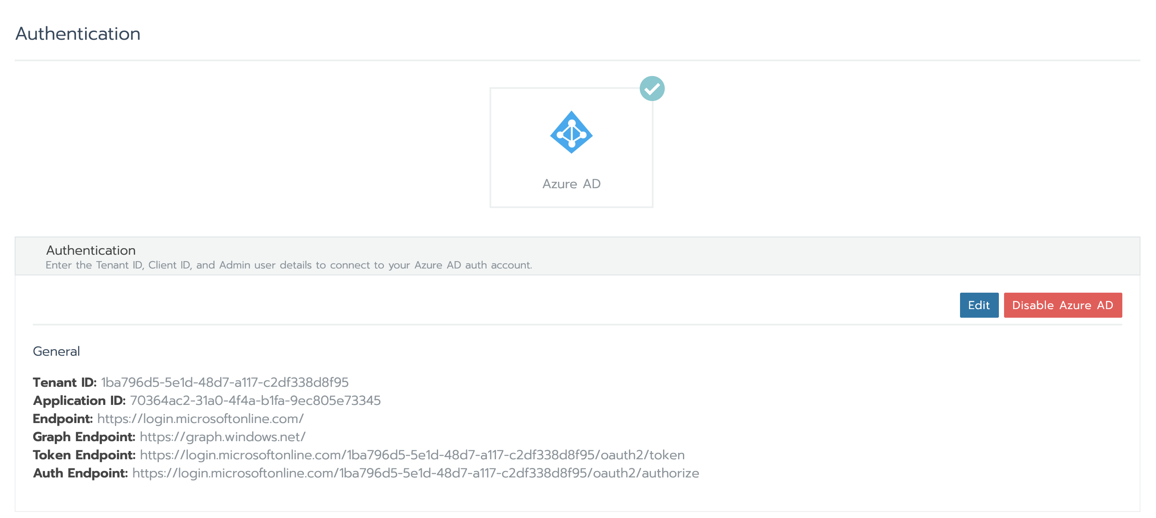
2.4.3 LAB: Connecting Rancher to Existing AD

Slide 42
Block 3
2.5
Projects & Namespaces
2.6
PVC & Storage Class
Cluster Management with Rancher

Slide 43
2.5 Projects & Namespaces
Projects
Namespaces
Resource Limits
Rancher Particularities
Best Practices
LAB: Project setup with Resource Limits

Slide 44
2.5.4 LAB: Project setup with Resource Limits
/Section 2/Labs/2.5.4/

Slide 45
2.5.4 LAB: Project setup with Resource Limits
Add Namespace ‘conduent’ to default project
Deploy Deployment with no Limit
Add Resource Limits
Add Resource Limit of 1cpu to project.
Add namespace ‘namb’ with 500mcpu limit, 500mcpu default.
Try to re-deploy deployment to same namespace
Deploy same deployment to new namespace
Try to deploy a workload without limits
Kubectl apply –f deployment.yaml

Slide 46
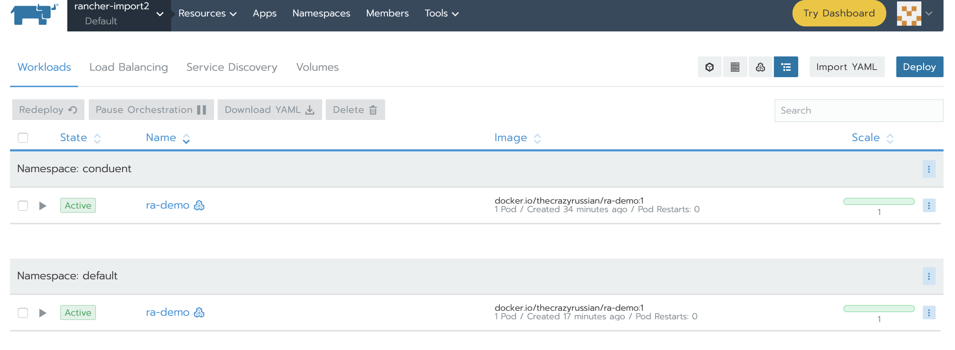
2.5.4 LAB: Project setup with Resource Limits

Slide 47
Block 3
2.5
Projects & Namespaces
2.6
PVC & Storage Class
Cluster Management with Rancher

Slide 48
2.6 Persistent Storage & Storage Classes
Storage Classes
Azure Blob Class
Persistent Volumes
Persistent Volume Claims
LAB: Add storage class and PVC via UI

Slide 49

2.6 Persistent Storage Concepts
Special types for persistence StatefulSet, Persistent Volume (PV), and persistent volume claim (PVC), Storage Class
PV
Handle formatting and attaching network or local storage to a path within the container (e.g. /opt/data)
Become bound to a Statefulset’s claim so they only get used for those types of pods
Work with a pluggable backend so they can be used the same way with different storage technologies
Storage Class defines all the settings needed to provision a type of storage
Notes:
- dynamic provisioning is only possible through storage classes

Slide 50
Reminder! Lab 2.6.4 Available in Github.
/Section 2/Labs/2.6.4/

Slide 51
2.6.4 LAB: Add storage class and PVC via UI
Rancher UI : Add Storage Class
Rancher UI : Add PV for Project
Rancher UI : Add PVC from PV

Slide 52
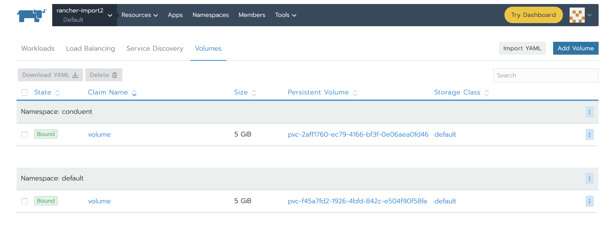
2.6.4 LAB: Add storage class and PVC via UI

Slide 53
Block 4
2.7
Monitoring
2.8
Logging
Cluster Management with Rancher

Slide 54
2.7 Monitoring
Review Existing System
Rancher UI Settings
Custom Metrics
Best Practices
LAB: Persistent Storage for P&G

Slide 55
2.7.5 LAB: Persistent Storage for P&G via UI
/Section 2/Labs/2.7.5/

Slide 56
2.7.5 LAB: Persistent Storage for P&G via UI
Rancher UI : Monitoring Settings
Rancher UI : Setup Cluster Monitoring
Rancher UI : Enable Persistent Storage

Slide 57
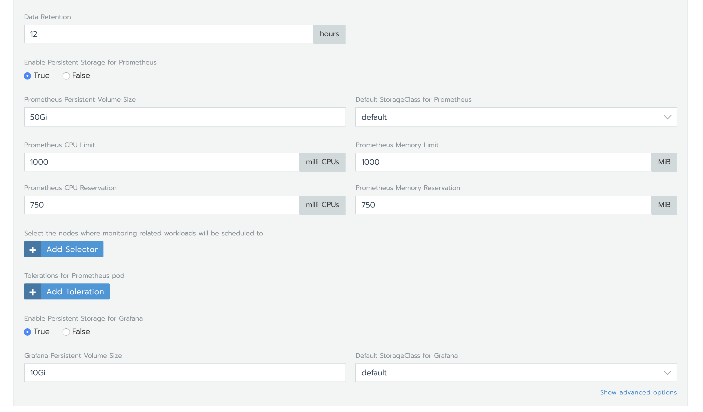
2.7.5 LAB: Persistent Storage for P&G via UI

Slide 58
Block 4
2.7
Monitoring
2.8
Logging
Cluster Management with Rancher

Slide 59
2.8 Logging
Review Existing System
Rancher UI Settings
Best Practices

Slide 60
2.8 Logging
Kubelet based log fetching
Centralized Logging
Docker log files are read by the kubelet and streamed out to clients
Kubectl logs [podname] - will cause the kubelet on the node running the pod to find the latest log file and stream its contents
Rancher’s console will display the log output from the kubelet as well
Complimentary to kubelet based logging
Involves forwarding log events to central log collection system which persists messages
Typically has some sort of indexing/searching component
Provides additional durability for logs beyond the node’s lifecycle (what happens when a node is terminated?)
Enables advanced analysis and visualization of log data
Examples: Splunk, Elasticsearch/Kibana, Greylog
Notes:
- multiple containers and hosts
- assumes json logging is used
- kubelet reads from file system of nodes
- in Rancher, click on pod, then view logs
- this is Kubernetes out-of-the-box behavior
- centralized logging is the next step
- advanced analysis like counting a specific error message
- some of the examples are available in Rancher catalog

Slide 61
Block 5
2.9
Continued Discussion Topics
2.10
Rancher 2.x Q & A
Cluster Management with Rancher

Slide 62
Block 5
2.9
Continued Discussion Topics
2.10
Rancher 2.x Q & A
Cluster Management with Rancher

Slide 63
Kubernetes Core Components

Slide 64
Block 6
3.1
Jobs
3.2
Cron Jobs
3.3
CRDs
Kubernetes Core Components

Slide 65
3.1 Jobs
Overview
They Complete
LAB: Setup and run a sample job.

Slide 66
3.1.2 LAB: Setup and run a sample job.
/Section 3/Labs/3.1.2/

Slide 67
3.1.2 LAB: Setup and run a sample job.
Open sample Job
Apply via kubectl
View Completed Job in UI and CLI

Slide 68
Block 6
3.1
Jobs
3.2
Cron Jobs
3.3
CRDs
Kubernetes Core Components

Slide 69
Block 6
3.1
Jobs
3.2
Cron Jobs
3.3
CRDs
Kubernetes Core Components

Slide 70
3.3 CRDs
Use cases
Examples
LAB: Example CRD setup

Slide 71
3.3.3 LAB: Example CRD setup
/Section 3/Labs/3.3.3/

Slide 72
3.3.3 LAB: Example CRD setup
View Sample CRD
Apply with kubectl

Slide 73
Security

Slide 74
Block 7
4.1
Security Topics
4.2
Pod Security Policies
Security

Slide 75
4.1 – Security Topics
More complete Security Topic Coverage
CIS Benchmarks
Image Scanning
Secret Encryption
Runtime Threat Detection
Process
Pod Security Policies
Network Plugins
Network Security
SSL Termination

Slide 76
Block 7
4.1
Security Topics
4.2
Pod Security Policies
Security

Slide 77
4.2 Pod Security Policies
LAB: Add Pod Security Policies to Local Rancher cluster
LAB: Deploy Secure and Unsecured Workload

Slide 78
4.2.1 LAB: Add Pod Security Policies to Local Rancher
/Section 4/Labs/4.2.1/

Slide 79
4.2.1 LAB: Add Pod Security Policies to Local Rancher
Modify the cluster.yml in Section 2/Labs/2.1.6
Update RKE in 2.1.6
Validate the install with test deployment
Create Role and Role Bindings.
Validate Again

Slide 80
4.2.2 LAB: Deploy Secure and Unsecured Workload
/Section 4/Labs/4.2.2/

Slide 81
4.2.2 LAB: Deploy Secure and Unsecured Workload
Deploy unprivileged workload
Add Restricted PSP
Set restricted as default
Test insecure deployment
Secure Role Binding
Test insecure deployment should work

Slide 82
Operational Usability

Slide 83
Block 8
5.1
Debugging
5.2
Application Versioning
Operational Usability

Slide 84
5.1 Debugging
Review
Best Practices
Operations
Developers
Rancher & Support Tools
Rancher UI
Sidecars
LAB: Add sidecar to a workload.
APM

Slide 85
5.1.3 LAB: Add sidecar to a workload.
/Section 5/Labs/5.1.3/

Slide 86
5.1.3.3 LAB: Add sidecar to a workload.
Show sidecar options, select sidecar to use.
Add Sidecar
Debug pod network traffic using sidecar.

Slide 87
Block 8
5.1
Debugging
5.2
Application Versioning
Operational Usability

Slide 88
5.2 Application Versioning
SemVer
Immutable Artifacts
Test Builds

Slide 89
Block 9
5.3
Scaling AKS
5.4
Out of Resource Handling
Operational Usability

Slide 90
5.3 Scaling with AKS & HPA
Cluster Auto Scaler
HPA
LAB: Scale with HPA

Slide 91
5.3 Scaling with AKS & HPA

Slide 92
5.3.1 Cluster Auto Scaler
KEDA uses asure functions to scale AKS automatically.
https://docs.microsoft.com/en-us/azure/aks/cluster-autoscaler

Slide 93
KEDA – Cloud Functions to Control Scaling
KEDA uses asure functions to scale AKS automatically.
https://keda.sh/
https://docs.microsoft.com/en-us/azure/azure-functions/functions-kubernetes-keda

Slide 94
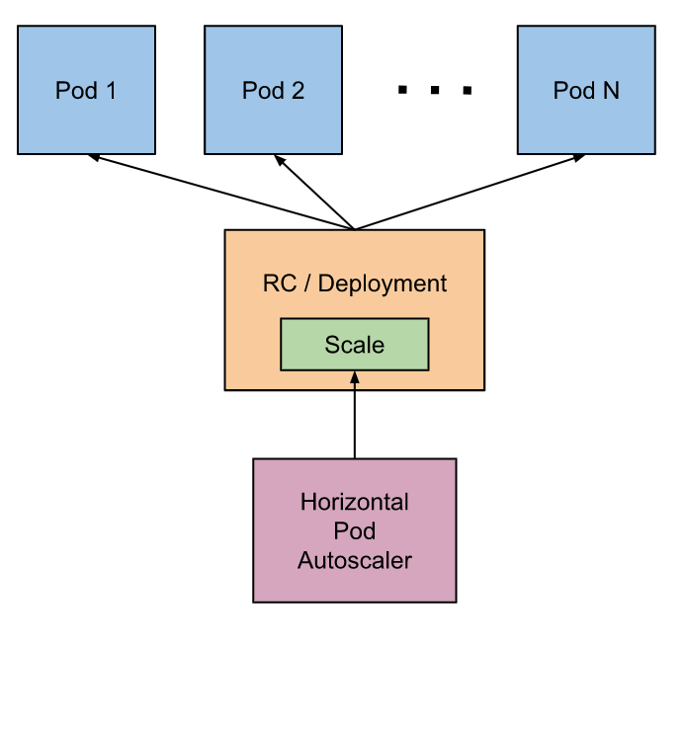
5.3.2 Horizontal Pod Autoscaler

Slide 95
5.3.3 LAB: Scale with HPA
/Section 5/Labs/5.3.3/

Slide 96
5.3.3 LAB: Add HPA
Add HPA to insecure deployment
Add cpu limits to deployment.

Slide 97
Block 9
5.3
Scaling AKS
5.4
Out of Resource Handling
Operational Usability

Slide 98
5.4 Out of Resource Handling
Handling out of Resource States
Pod Disruption
Pod Priority
QoS Classes
LAB: Resource Prioritization

Slide 99
5.4 Out of Resource Handling
1. Handling out of Resource States
Utilize Prioritization, Disruption Budgets, and QoS to gracefully degrade services.
Use alerting to let you know it is happening.
Scale externally when you can.

Slide 100
5.4 Out of Resource Handling
2. Pod Disruption Budget
Specifies number of pods in a deployment that can be unavailable at a time.

Slide 101
5.4 Out of Resource Handling
3. Pod Priority Classes
We will lab in depth. Help the scheduler determine which pods will get evicted.

Slide 102
5.4 Out of Resource Handling
4. QoS Classes
A Kubernetes concert that determines the scheduling and eviction of pods. It is used to make scheduling decisions.

Slide 103
5.4.5 LAB: Resource prioritization
/Section 5/Labs/5.4.5/

Slide 104
5.4.5 LAB: Resource prioritization
Restrict Resource Availability in Project
Deploy Low Priority Workload
Deploy High Priority Workload
Show which deployments work based on prioritization.

Slide 105
Concluding Discussions

Slide 106
Block 10
6.1
Continued Discussion Topics
6.2
Training Q & A
Concluding Discussions

Slide 107
Block 10
6.1
Continued Discussion Topics
6.2
Training Q & A
Concluding Discussions

Slide 108
Post Training

Slide 109
Day 10+
1
Training Material for Reference
2
High Level Design Document
Next Steps

Slide 110
Training Material for Reference
This Updated PPT
Updated Zip containing Labs and Resources.

Slide 111
Day 10+
1
Training Material for Reference
2
High Level Design Document
Next Steps

Slide 112
Thank You

